Slide 1
Tour of Europe!

Slide 2
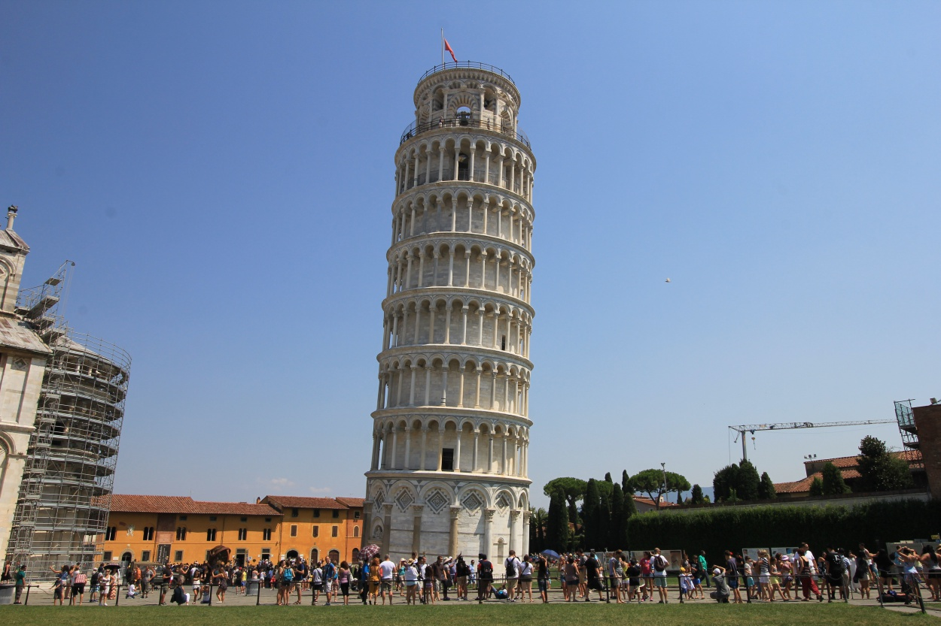

Leaning Tower of Pisa, Italy
Move: Tower Tilt
Notes:
http://thisgirlabroad.com/wp-content/uploads/2015/12/leaning-tower-of-pisa-1.jpg

Slide 3
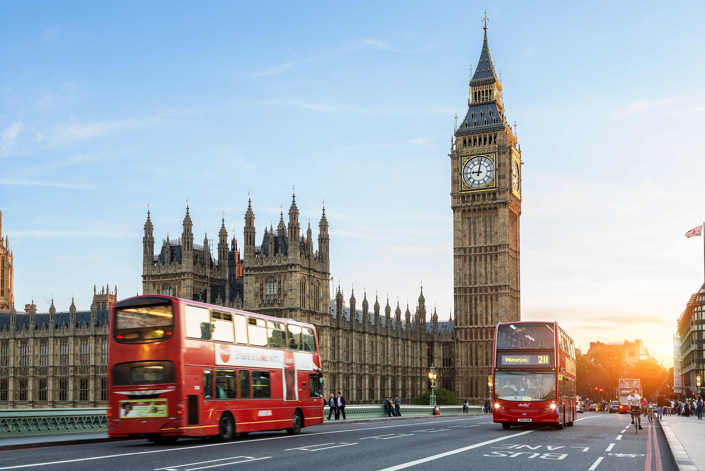
Big Ben, England
Move: Tic Toc
Notes:
http://media.cntraveler.com/photos/571f9be4afc531496352d2a9/master/pass/GettyImages-174726708.jpg

Slide 4
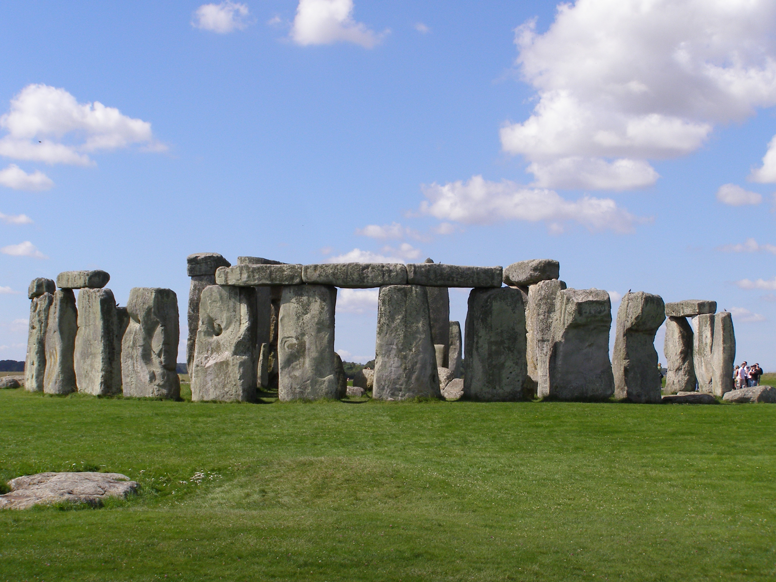
Stonehenge, England
Move: Stone Lift
Notes:
https://upload.wikimedia.org/wikipedia/commons/3/3c/Stonehenge2007_07_30.jpg

Slide 5
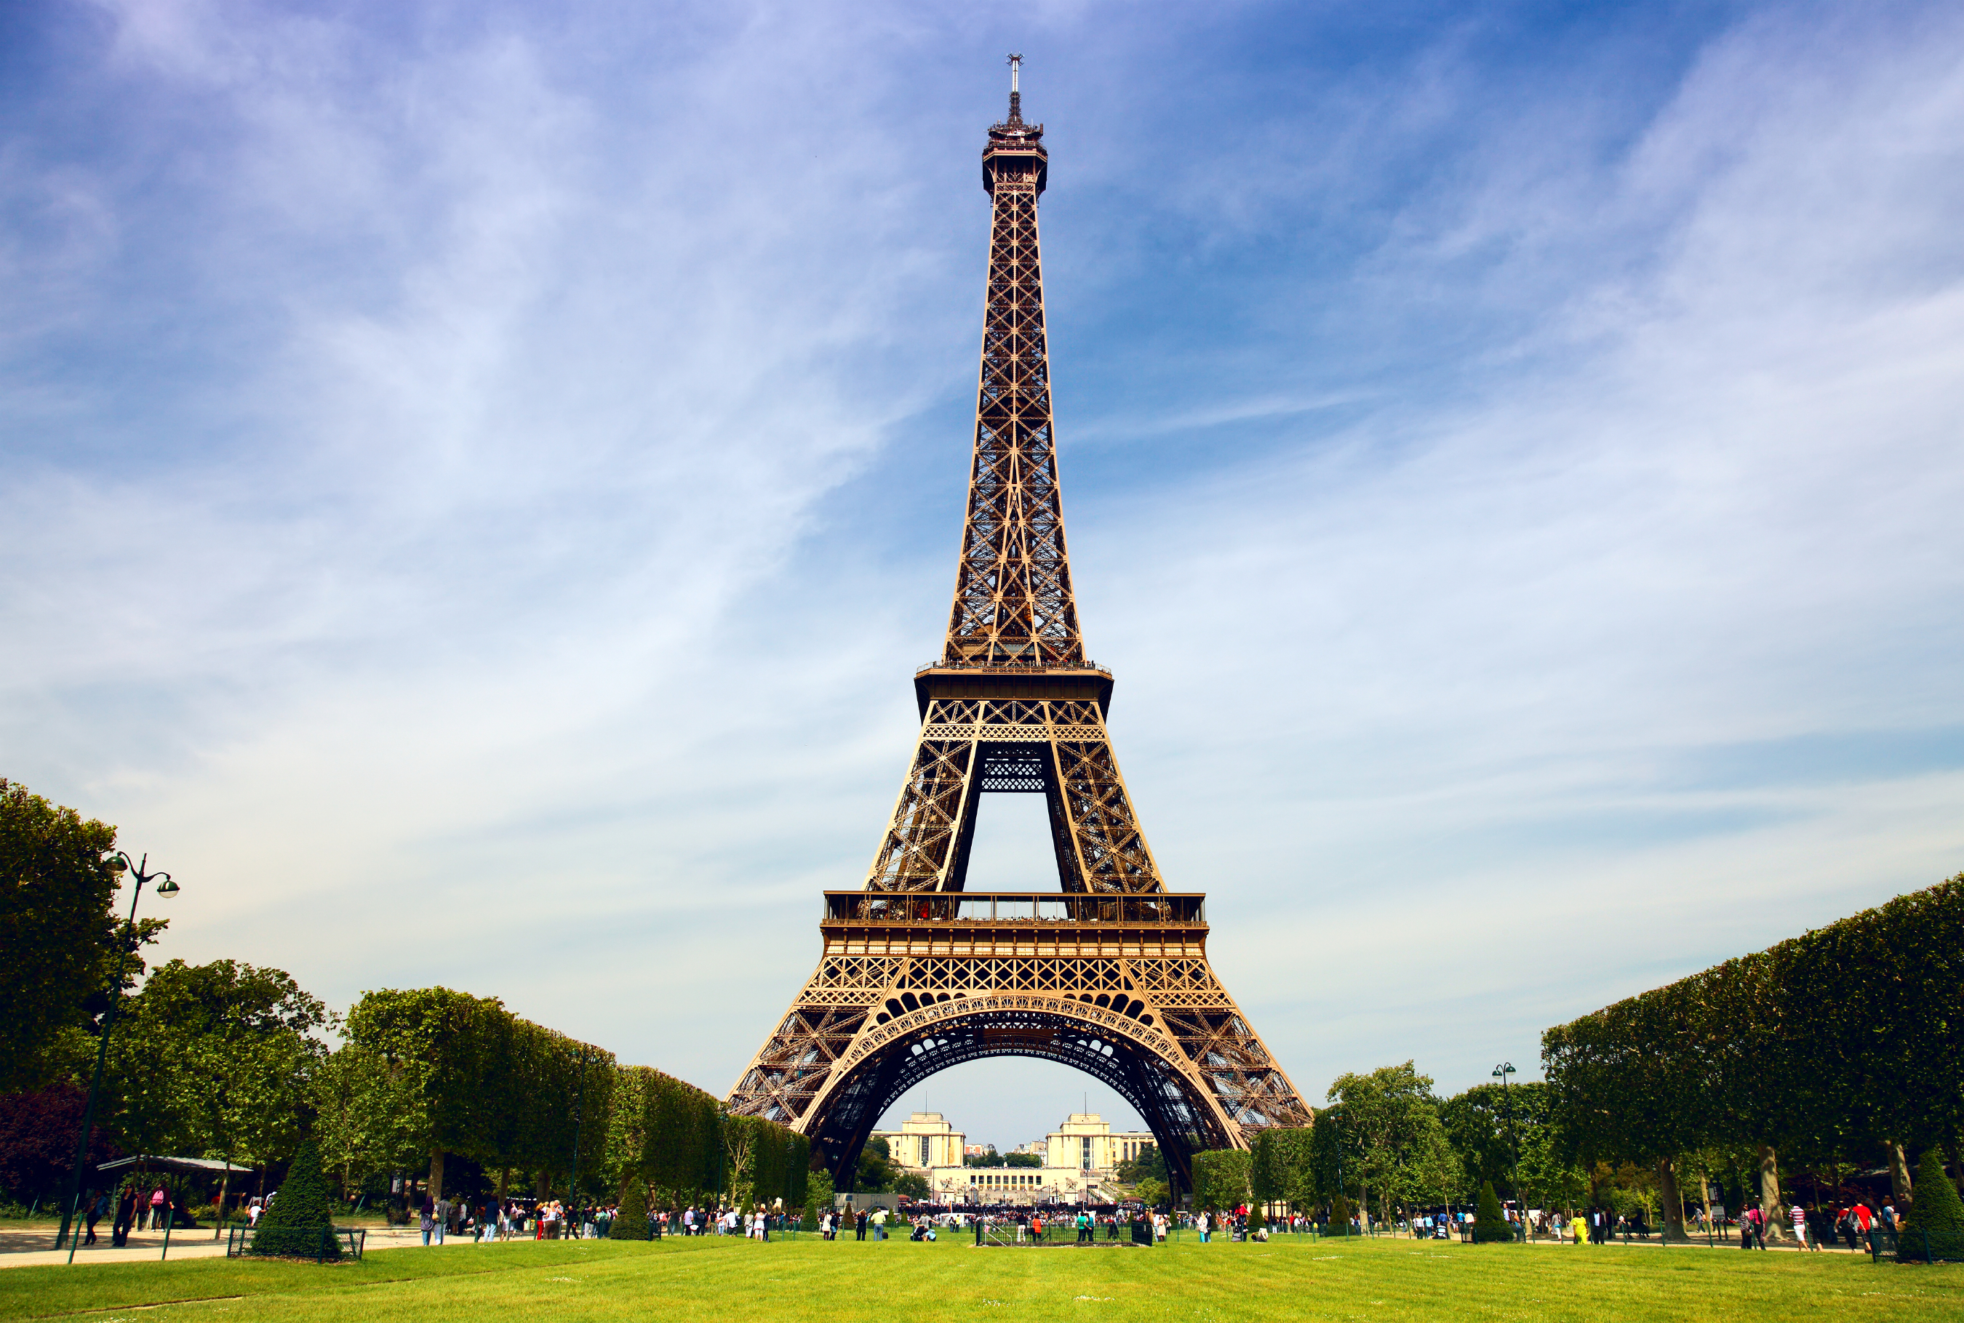
The Eiffel Tower, France
Move: Eiffel Pose
Notes:
http://cdn.history.com/sites/2/2015/04/hith-eiffel-tower-iStock_000016468972Large.jpg

Slide 6
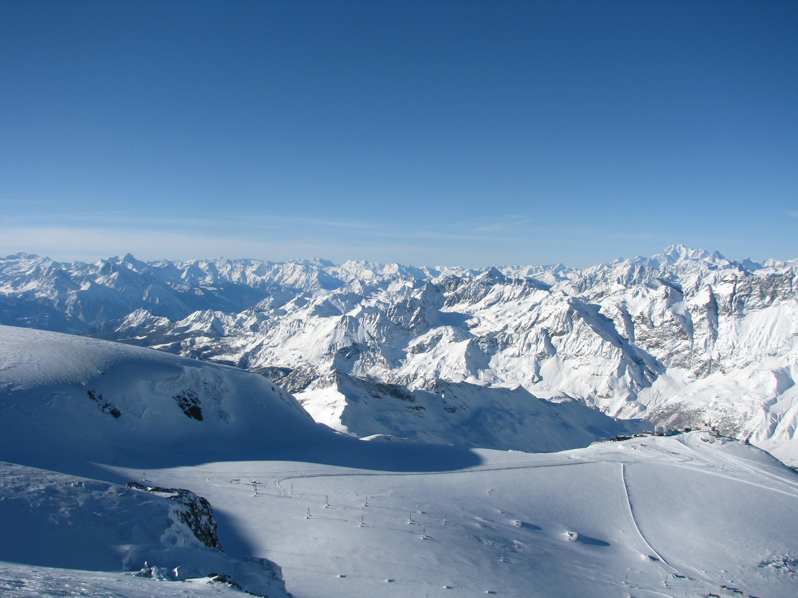
The Alps, Switzerland
Move: Skii Jump
Notes:
https://upload.wikimedia.org/wikipedia/commons/5/53/Swiss_Alps.jpg

Slide 7
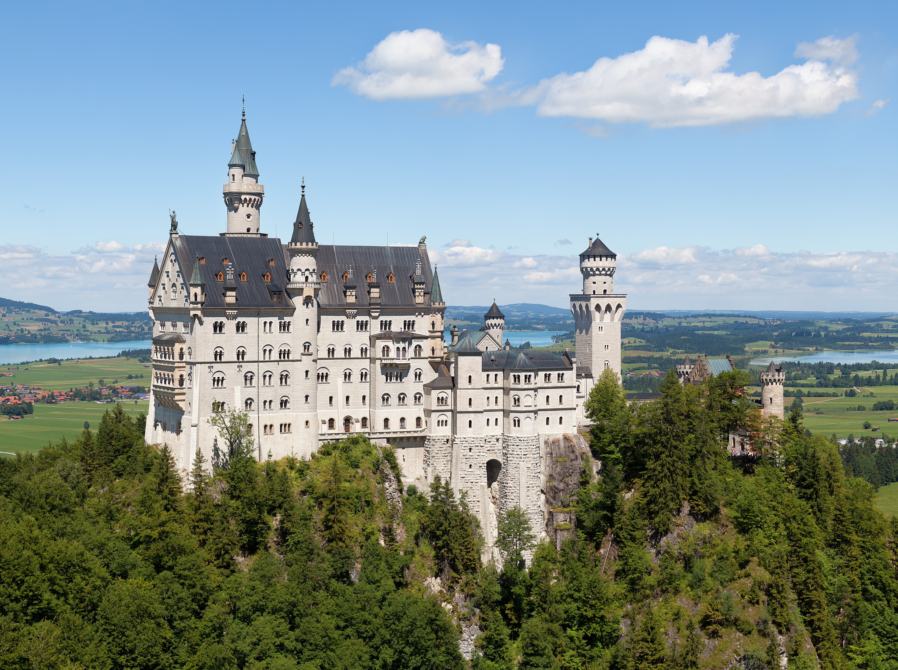
Neuschwanstein Castle, Germany
Move: Royal Kneel
Notes:
https://upload.wikimedia.org/wikipedia/commons/f/f8/Schloss_Neuschwanstein_2013.jpg

Slide 8
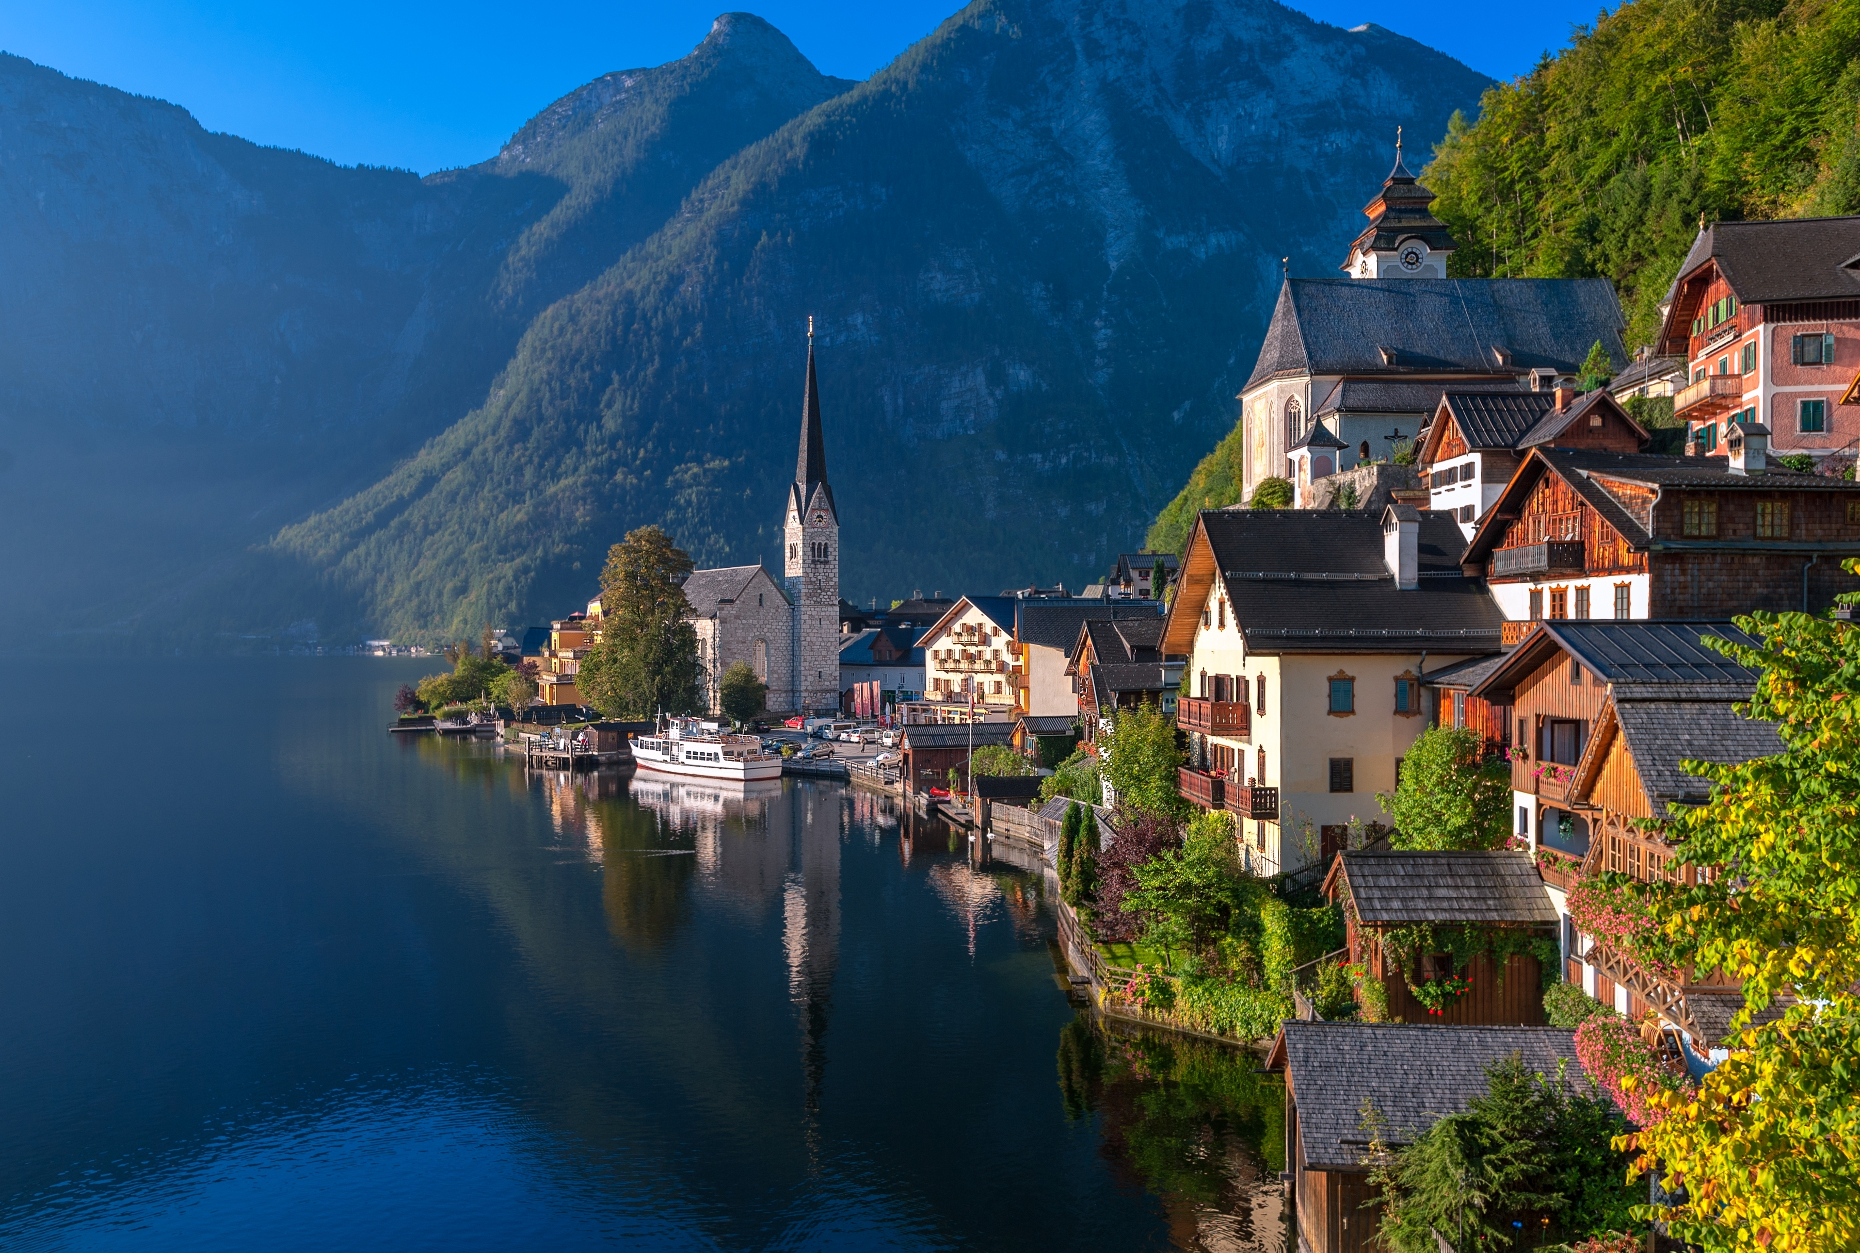
Move: Lake Jumping
Hallstatt, Austria
Notes:
http://kingofwallpapers.com/hallstatt/hallstatt-023.jpg

Slide 9
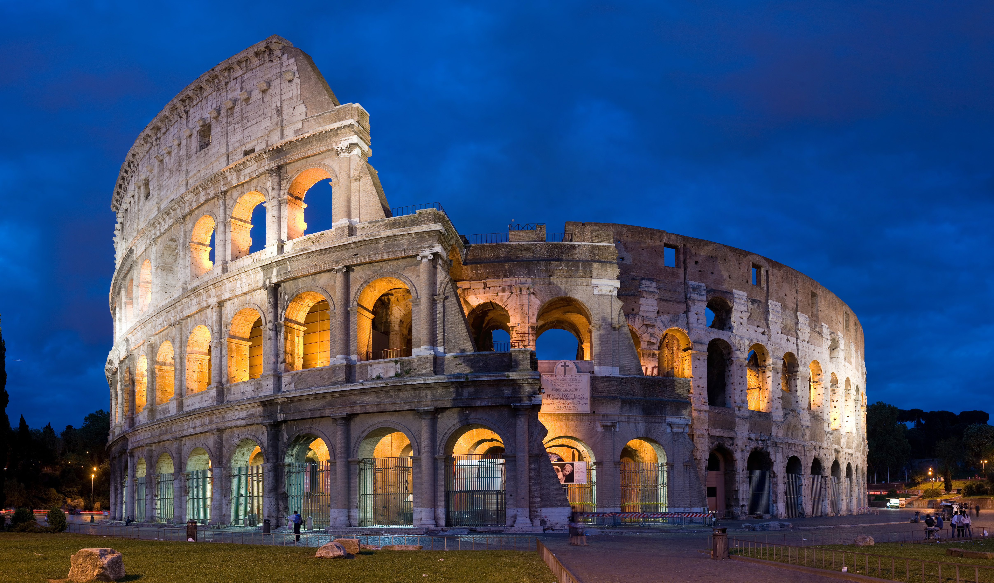
The Colosseum, Italy
Move: Gladiator Punch
Notes:
https://upload.wikimedia.org/wikipedia/commons/5/53/Colosseum_in_Rome,_Italy_-_April_2007.jpg

Slide 10
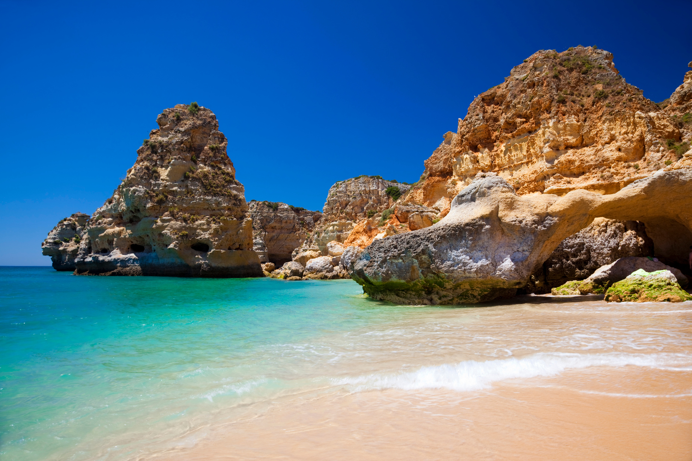
Algarve, Portugal
Move: Wave Splashing
Notes:
https://www.lonelyplanet.com/travel-blog/tip-article/wordpress_uploads/2015/04/Praia-da-Marinha-Algarve_CS.jpg

Slide 11
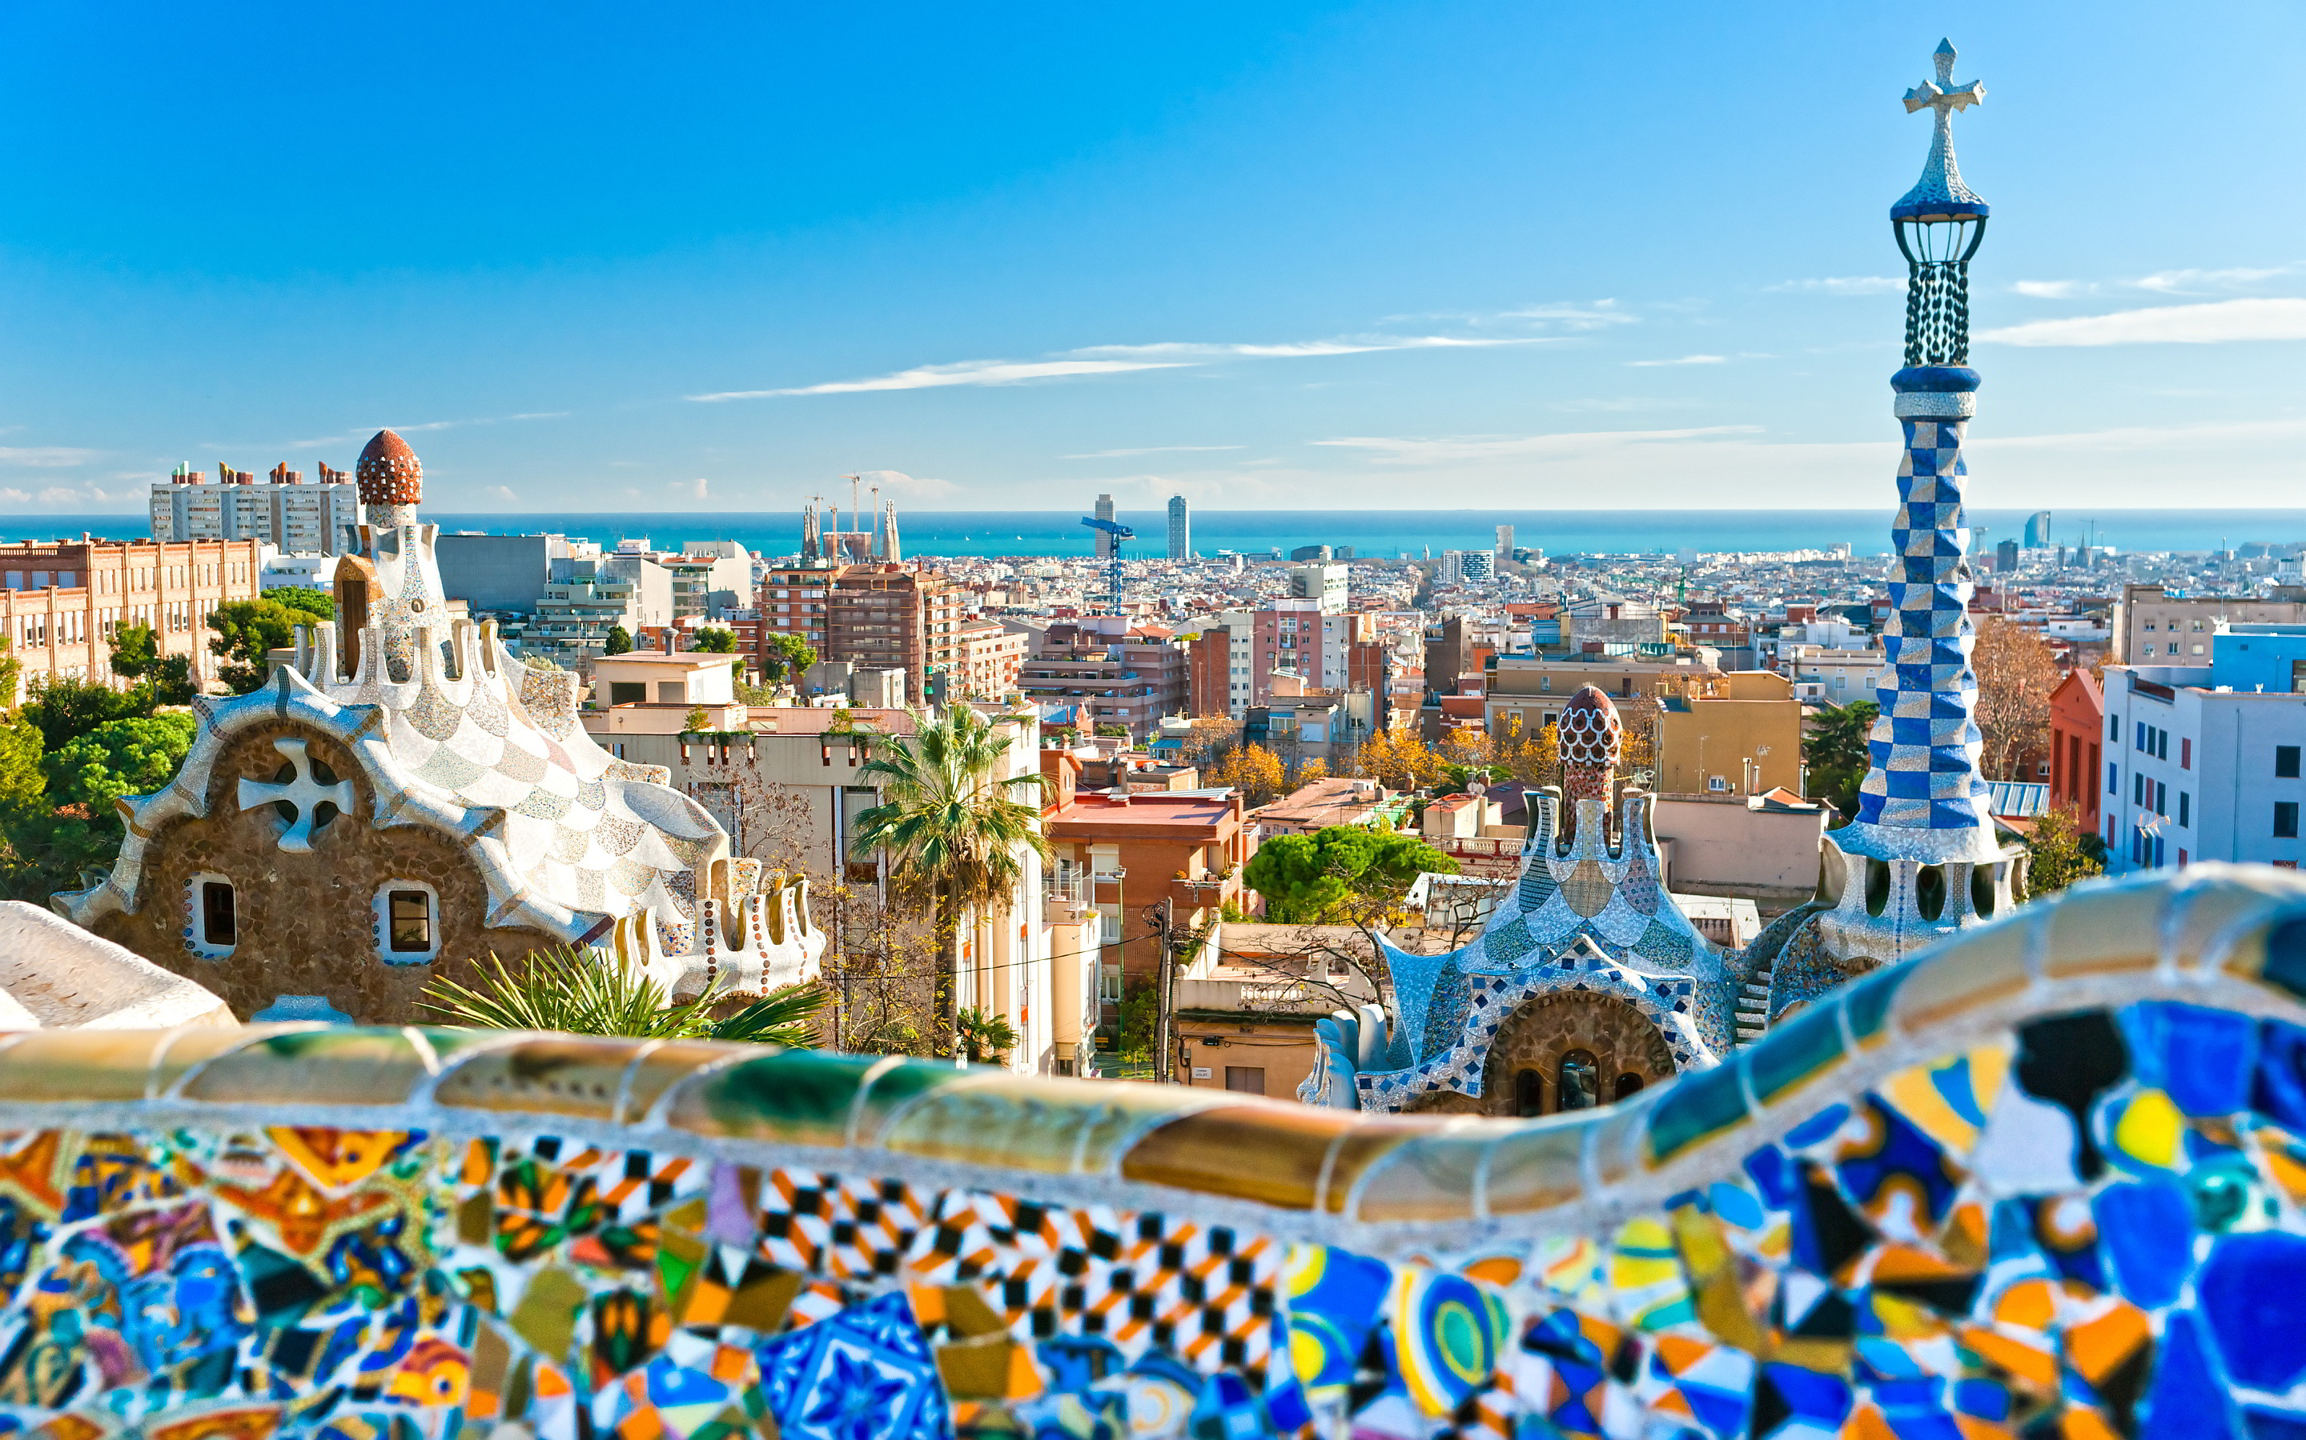
Barcelona, Spain
Move: Spanish Dance
Notes:
http://2015.phpconference.es/wp-content/uploads/2015/05/barcelona-spain-1.jpg

Slide 12
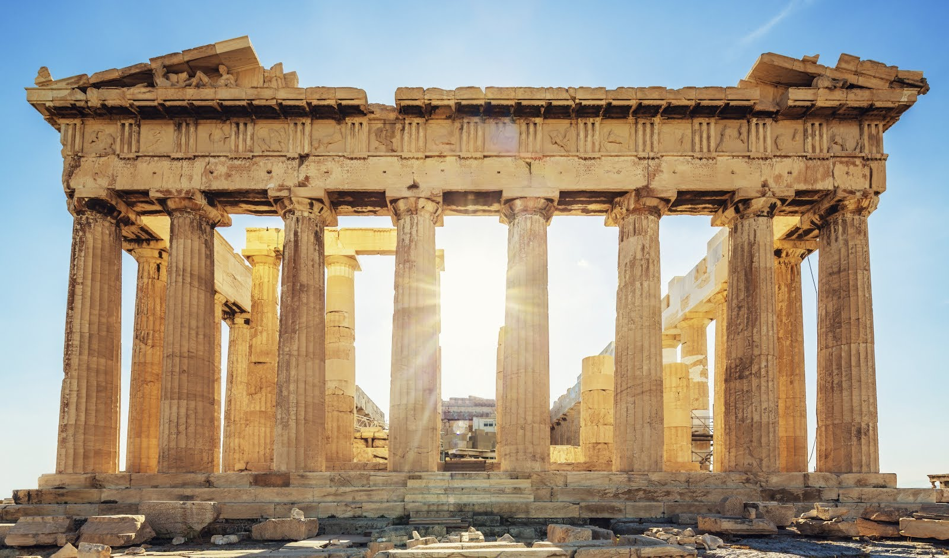
The Parthenon, Greece
Move: Greek God Pose
Notes:
http://www.nfl.com/photos/0ap1000000214278/0ap2000000214277

Slide 13
Freestyle!

Slide 14
Great job!

